Slide 1
Intuilize – Cluster Commanders Customer Segmentation & Prediction Weekly Meeting 2/28/2025
Andy, Graham, Keertana, & Shashank

Slide 2
Agenda
Markov-chain
Clusters Scatterplot
Feature Removal & Weights
Data Model Design Document

Slide 3
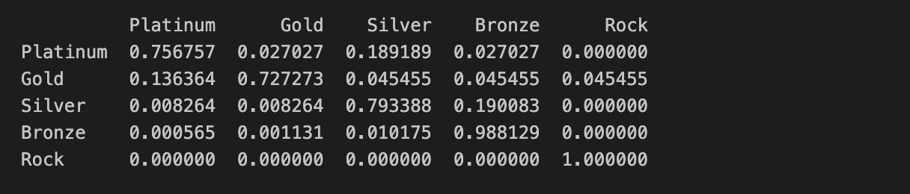
Markov Chain

Slide 4
Features Selected & Removed
Total Revenue
Total Profit
Total Unit Price
Total Sales Quantity
Order Count
Number of Distinct Products
Number of Distinct Product Groups
Branch Count
Customer Lifetime in Days
High Profit Order Ratio
Popular Order Ratio
Repeat Purchase Ratio

Slide 5
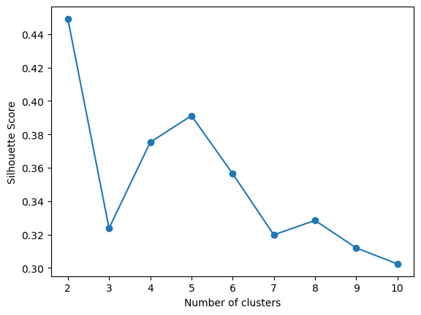
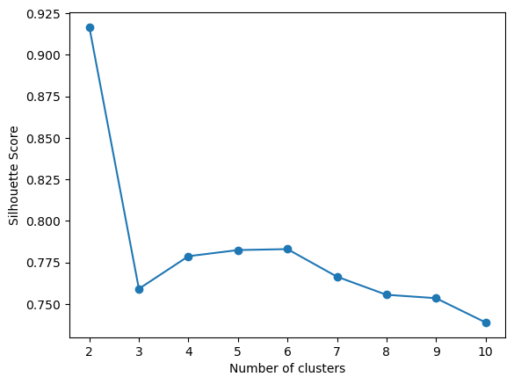
Removing Features
All Features
Removed Features

Slide 6
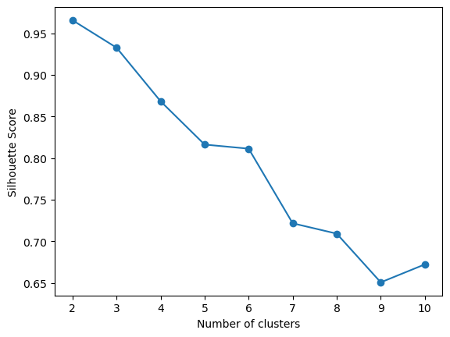
Silhouette scores for cluster numbers
Unweighted
Weighted

Slide 7
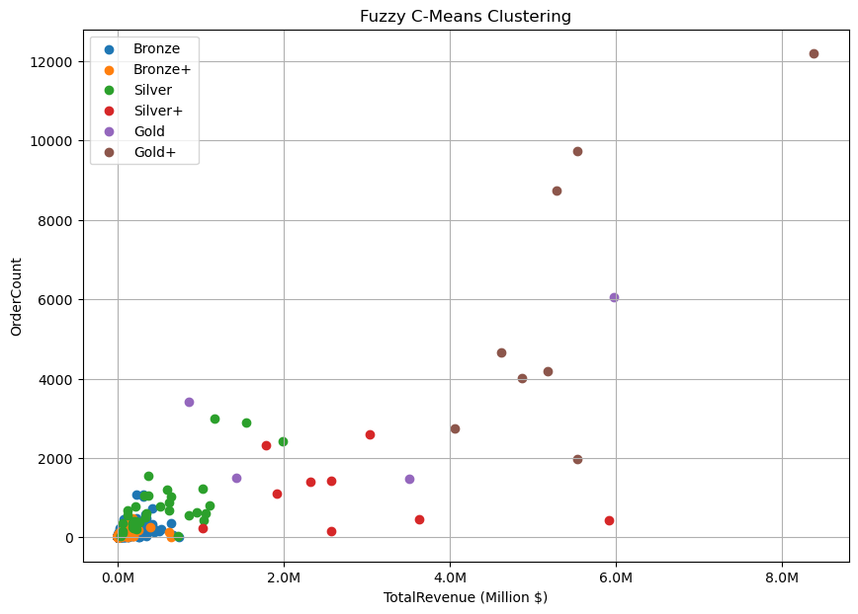
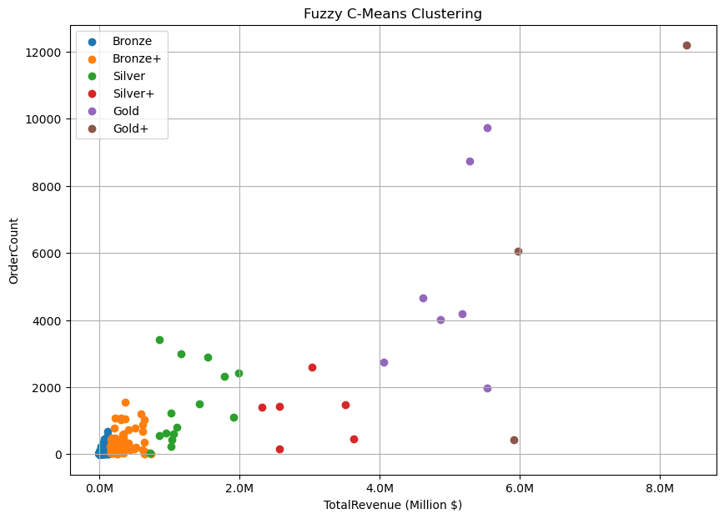
Clustering
Unweighted
Weighted

Slide 8
Data Model Design Document
Data model design document is almost complete.
Should segmentation model be discussed or just data analysis?

Slide 9
Next Steps
Use transition matrix to complete prediction model
Complete data model design document

Slide 10
THANK YOU!

